Slide 1



AUTOMOTIVE
HACKING
De Silva K.R.K.D

Slide 2

ABSTRACT
Today’s vehicles are connected
various methods used by to compromise the security
Final Impacts
Loss of data and money
Loss of lives

Slide 3


INTRODUCTION
vehicles are one of the most sold items in the market
Today’s vehicles come loaded with
computerized technology
They have many kind of vulnerabilities

Slide 4

EVOLUTION
Historical Overview
Automotive hacking has a history of almost 20 years
Major Incidents
2010 - ECU Control
2015 - Miller and Valasek's Jeep Hack
2015 - Tesla Model S
2016 - Jeep Theft

Slide 5
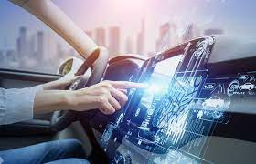
TYPE OF ACCESSS
physical access
Keyless Entry
Telematics
Smartphone Access

Slide 6

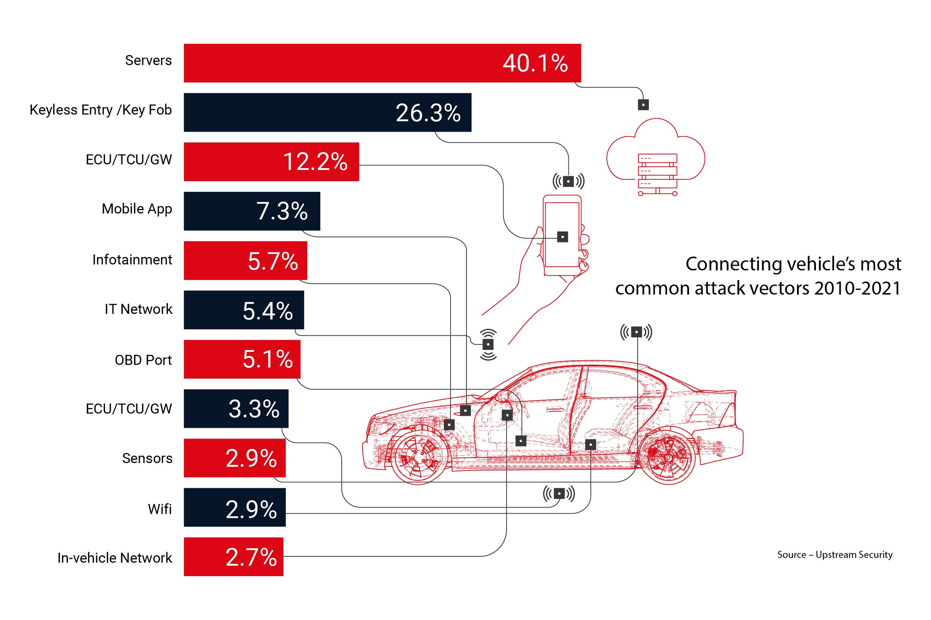

Slide 7
VULNERABILITIES IN TODAY’S AUTOMOBILES
Door Locks
Gatekeeper and Protocol Vulnerability
Systems for-on board diagnostics
In-vehicle infotainment systems
Telematics systems

Slide 8
IMPACTS
Financial Impacts
Risks and Consequences
LOSE UP TO $24 BILLION IN THE NEXT 5 YEARS
Remote Control Takeover
Data Theft
40
30
20
10
0
Item 1
Item 2
Item 3
Item 4
Item 5

Slide 9





INNOVATIVE APPROACHES TO INDUSTRY CHALLENGES
Segmentation and Isolation
Secure Software Updates
Secure Boot
Encryption
Intrusion Detection System (IDS)
Penetration Testing

Slide 10

Industry Collaboration and Standards
01
02
03
UNECE R 155
ISO/SAE 21434
UNECE WP.29
Mandates a CSMS for automakers, guaranteeing ongoing safety assessments and risk mitigation.
Sets cybersecurity standards for vehicle lifecycles, aiming for legal enforceability in the automotive industry
Enforces global cybersecurity and software update standards for new passenger vehicles

Slide 11
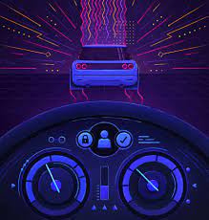



FUTURE DEVELOPMENT
The Security of Autonomous Vehicles
Supply chain security
Data Privacy and Regulations
Integration with Smart Infrastructure

Slide 12

CONCLUSION
Vehicle attacks are gradually increasing every year.
Automobiles have a greater impact on people's lives.
More focus is needed for the safety of automobile.

Slide 13


THE END
THANKS!

